Slide 1
DESIGN OF (ALU)
ARITHMETIC LOGIC UNT
Mansoura University
ECE Department

Slide 2



TEAM MEMBERS
AMR LABIB ISSA
HASSAN MUHAMMED JUHA
ELSAYED ASHRAF

Slide 3
AGENDA
Overview of the project
Schematic of the project
clock divider Block
Debouncing Block
ALU block
Binary to BCD Block
Implementation of 7 segment display on FPGA
Anode Select Block
Digit Control Block
7-segment decoder Block
Module ALU TOP

Slide 4
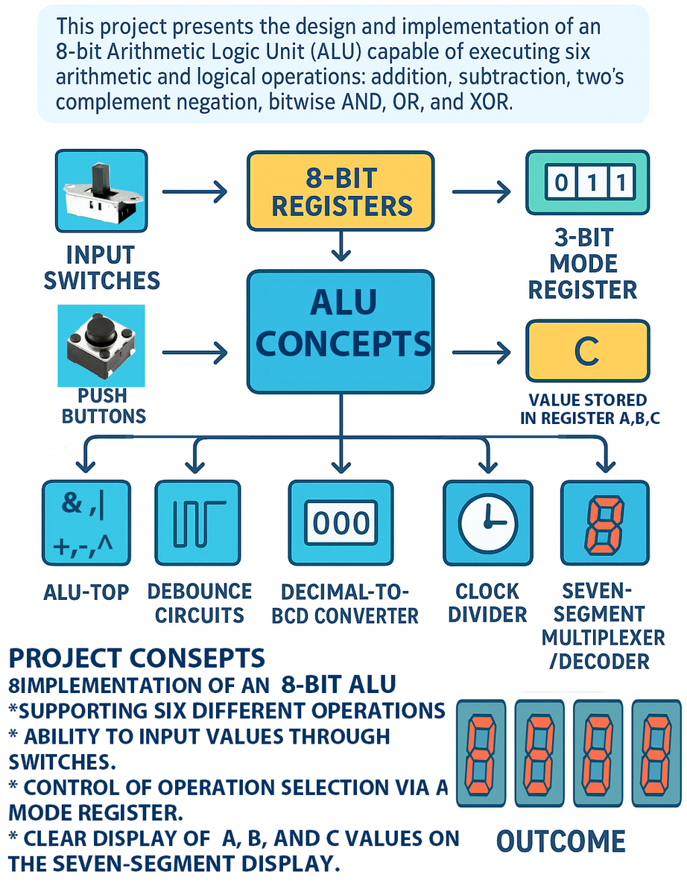
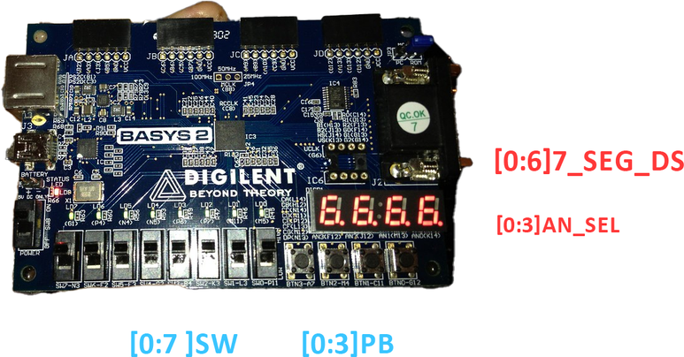

OVERVIEW OF THE PROJECT
Design and implement an 8-bit Arithmetic Logic Unit (ALU).
Data Handling:
Operands loaded into 8-bit registers A and B via switches and push buttons.
Results stored in register C.
Operation selected using a 3-bit mode register.
Supported Operations (6 total):
Addition
Subtraction
Two’s complement (negation)
Bitwise AND
Bitwise OR
Bitwise XOR
Output Display:
Result shown in decimal form on seven-segment displays.
System Modules:
ALU_TOP (main control)
Debounce circuits (stable inputs)
Decimal-to-BCD converter
Clock divider
Seven-segment multiplexer/decoder
Outcome:
A fully functional 8-bit ALU system demonstrating:
Digital design principles
Modular implementation
Hardware-based arithmetic & logic processing

Slide 5
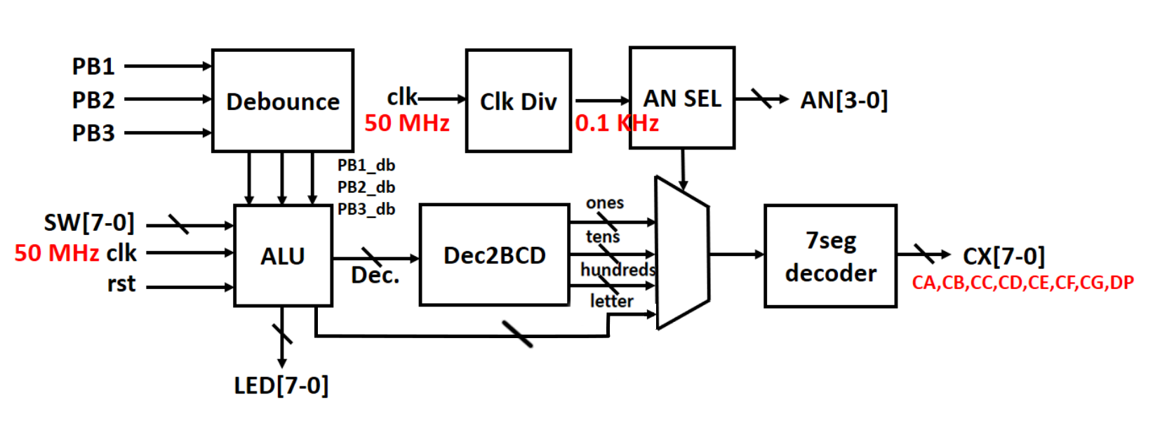
A BLOCK DIAGRAM OF THE PROJECT
6

Slide 6
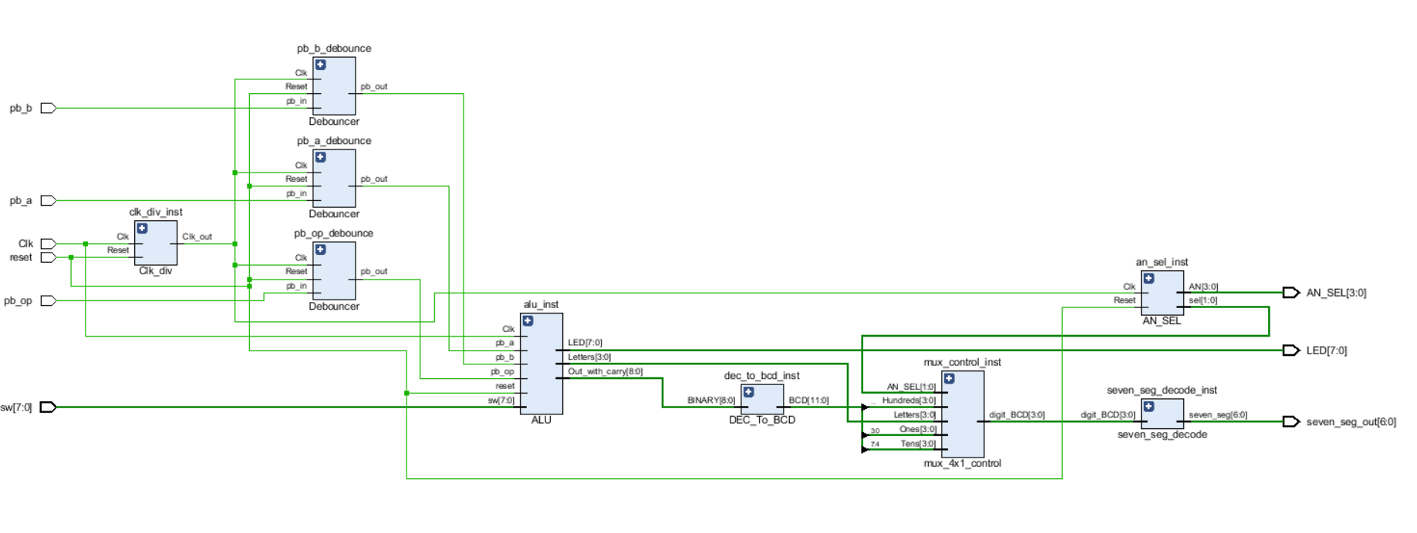
A schematic of the project

Slide 7
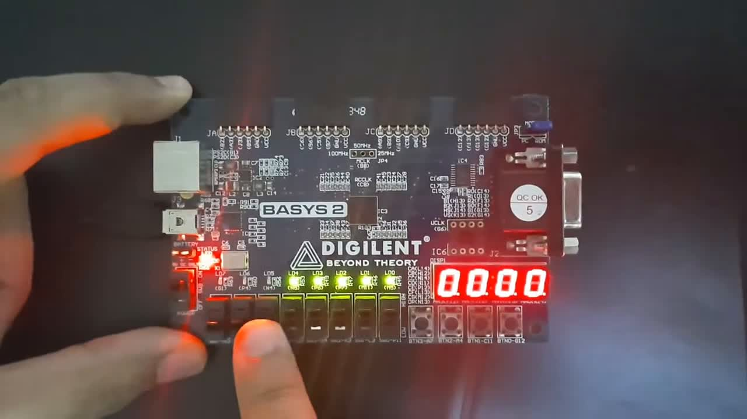
OVERVIEW OF THE PROJECT

Slide 8
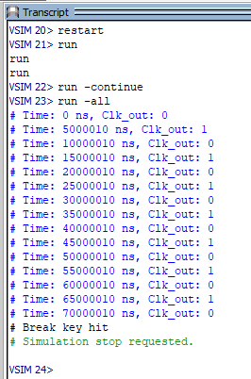
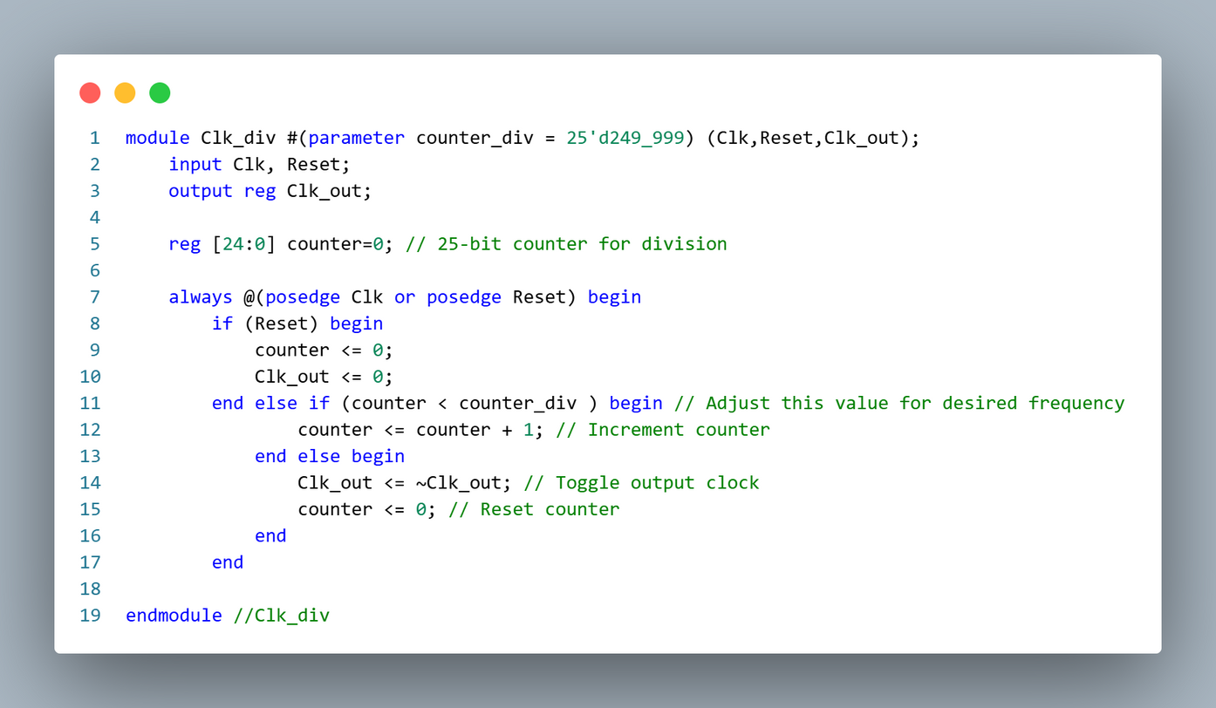
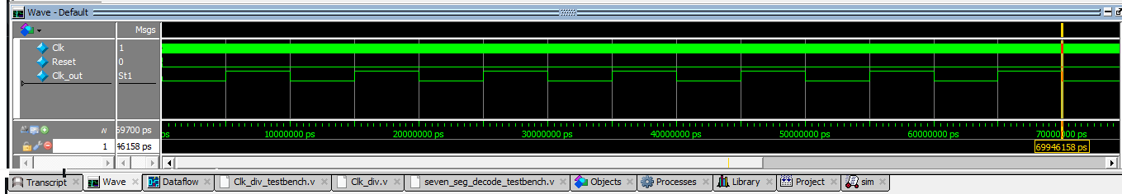
CLOCK DIVIDER
A clock divider is a digital circuit used to reduce the frequency of a high-speed clock signal and generate a slower clock output.
It works by counting the input clock pulses using an internal counter.
Once the counter reaches a predefined value, the circuit toggles the output clock and resets the counter.
Repeating this process produces an output clock with a lower frequency but the same duty cycle (approximately 50%).
A reset input ensures the divider can be initialized to a known state at any time.
This logic is widely used in timing control, digital systems, and embedded applications where slower clock signals are required from a high-frequency source.
50 MHZ
100 HZ

Slide 9
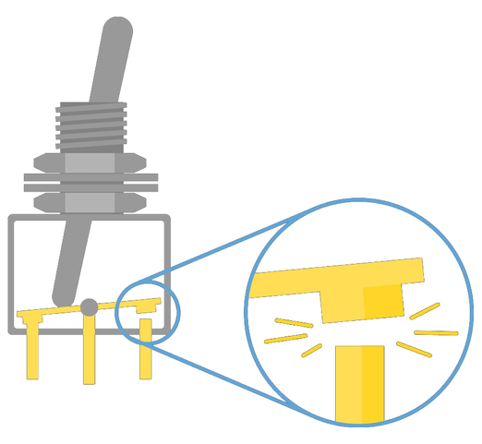
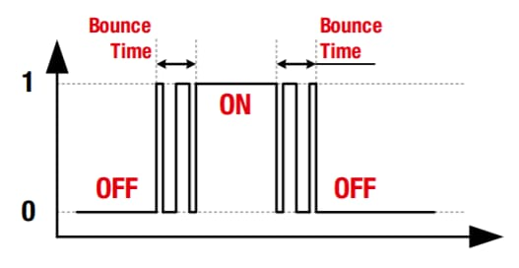
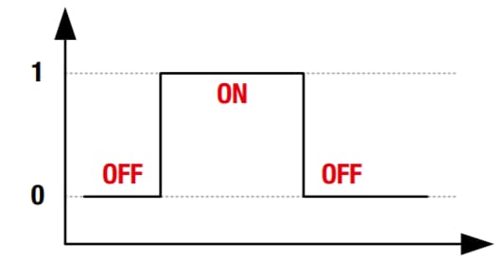
DEBOUNCING BLOCK
Bouncing occurs when two metal contacts in an electronic device generate multiple signals as they close or open. Debouncing is a hardware or software technique that ensures only a single signal is acted upon for each opening or closing of a contact.
Ideal switch
VS
Bouncing switch

Slide 10
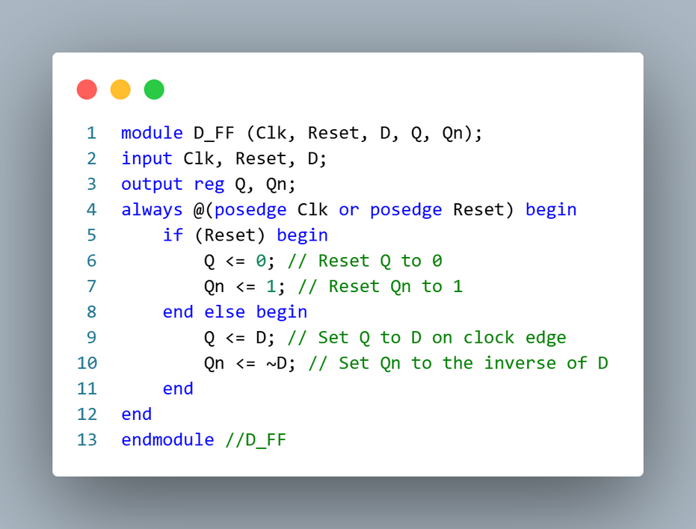
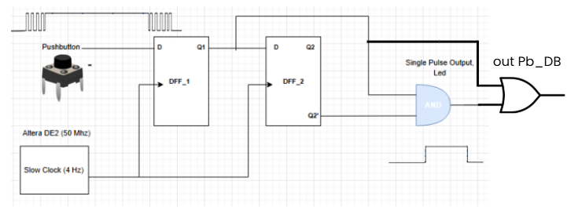
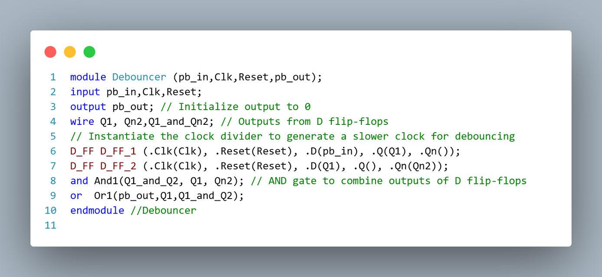
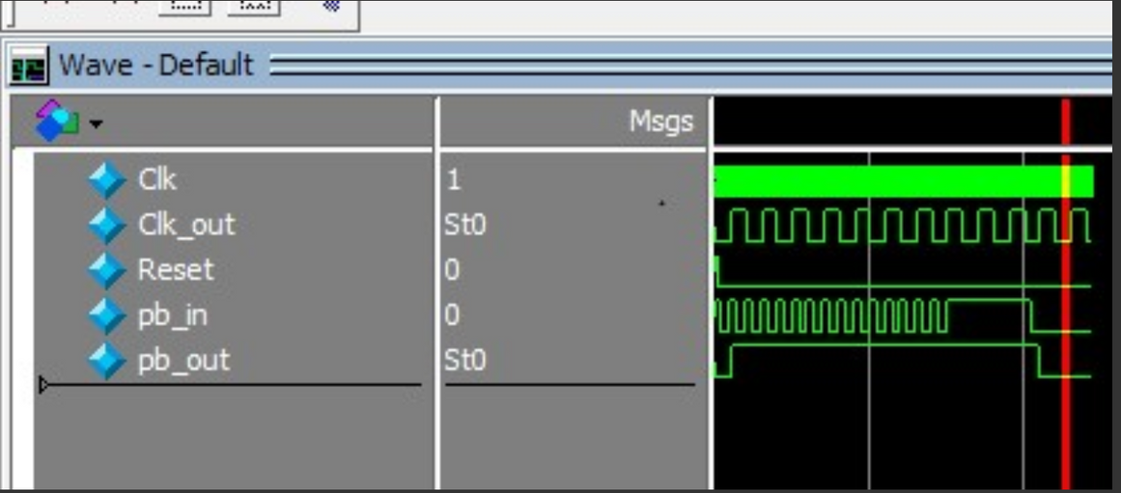
DEBOUNCING MODULE :

Slide 11
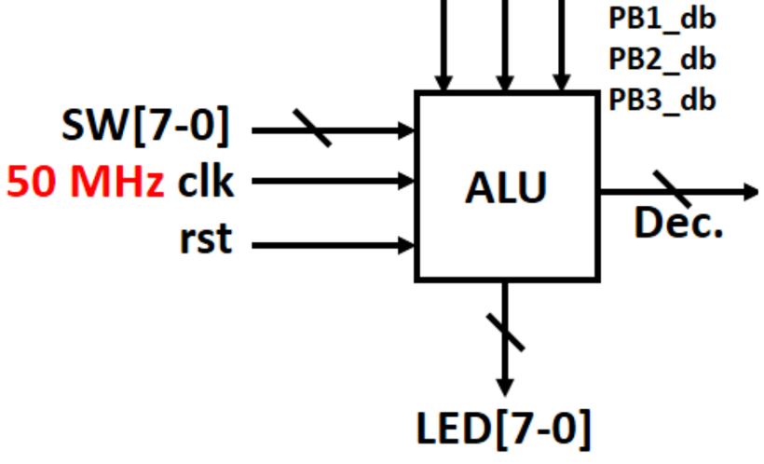
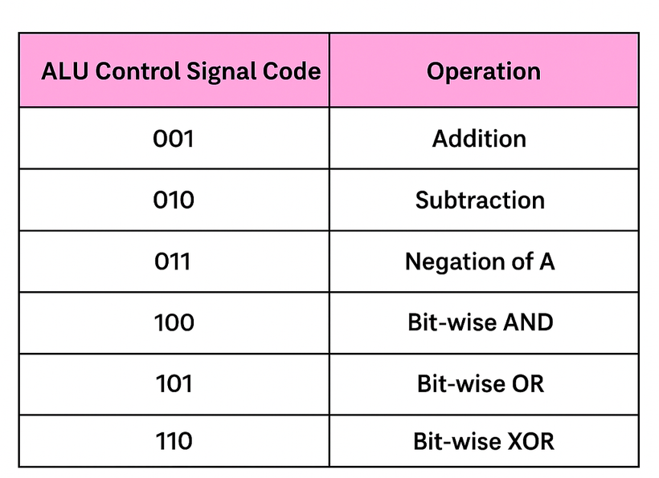

ALU BLOCK
An ALU (Arithmetic Logic Unit) is a digital circuit designed to perform arithmetic and bitwise logical operations on binary values. It operates on binary numbers at the bit level for logical procedures and on entire numbers for arithmetic operations.
Letter[3:0]
The registers are clocked by the global clock and the loading of these registers is controlled by the push buttons where :
• “Push button 0” is for register A
• “Push button 1” is for register B
• “Push button 2” is for register C
• "MODE" register form SW2, SW1, SW0 controls the function of ALU

Slide 12
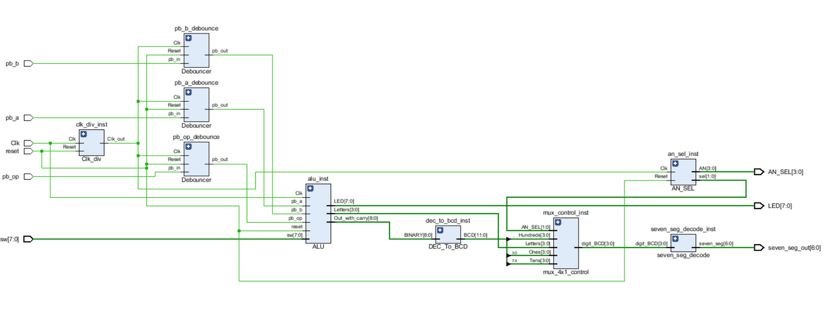
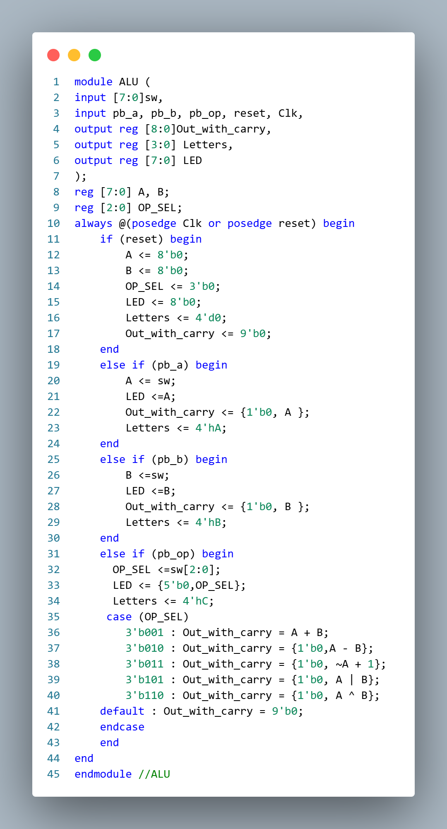
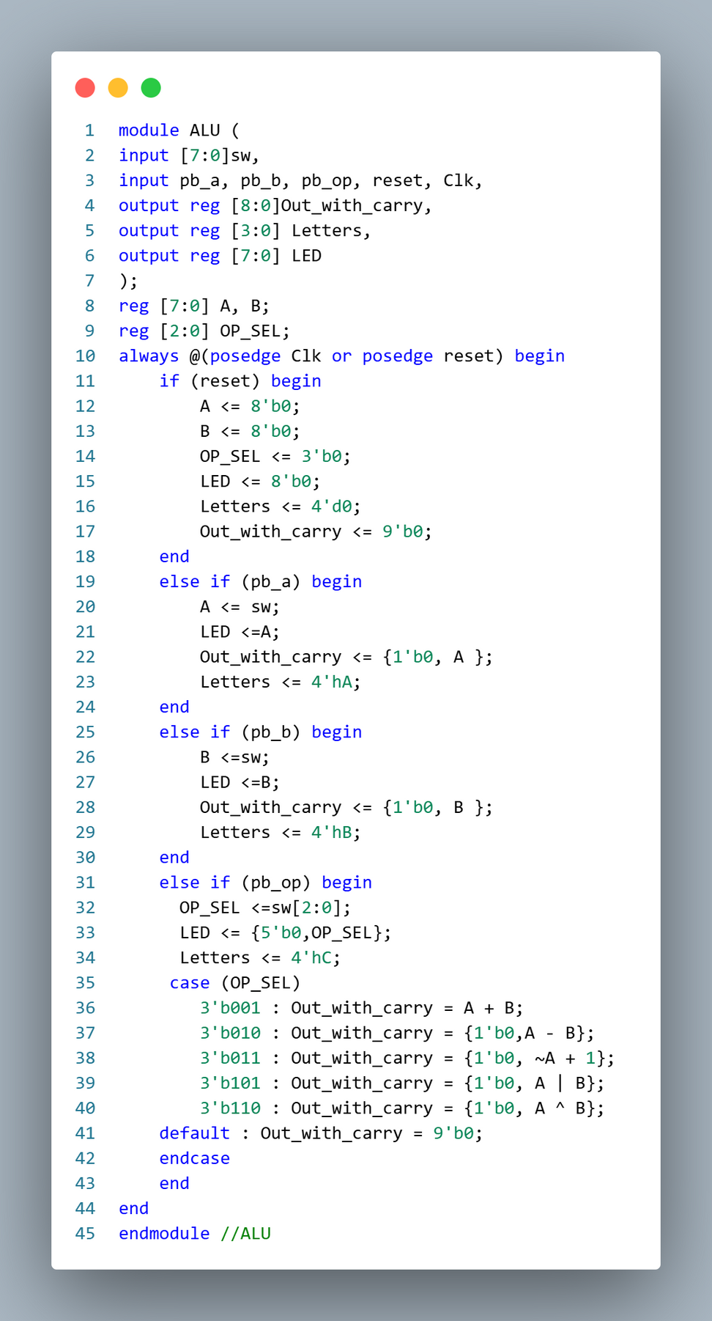
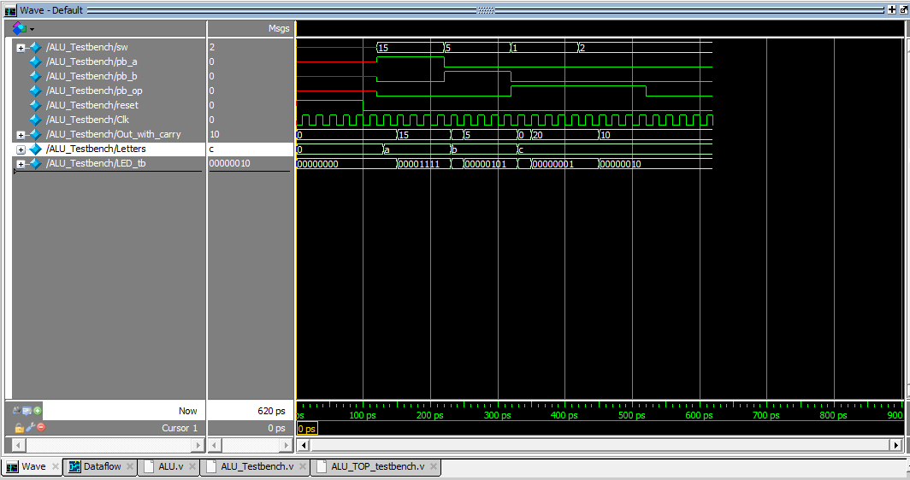
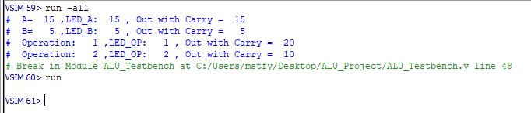
ALU BLOCK

Slide 13
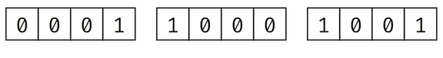
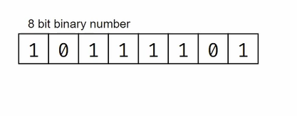
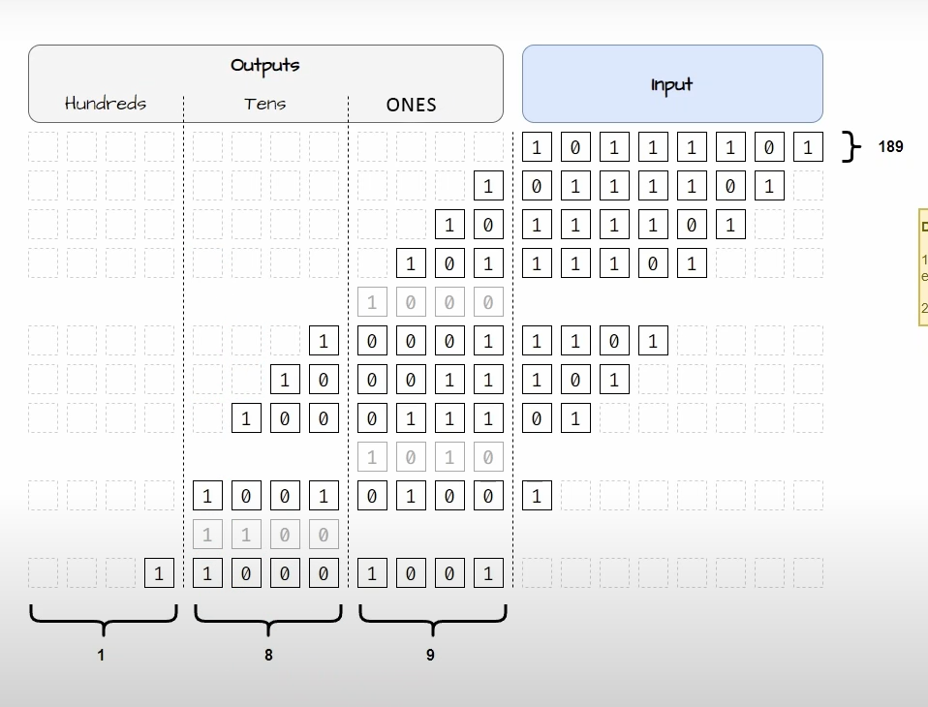
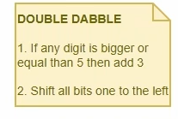
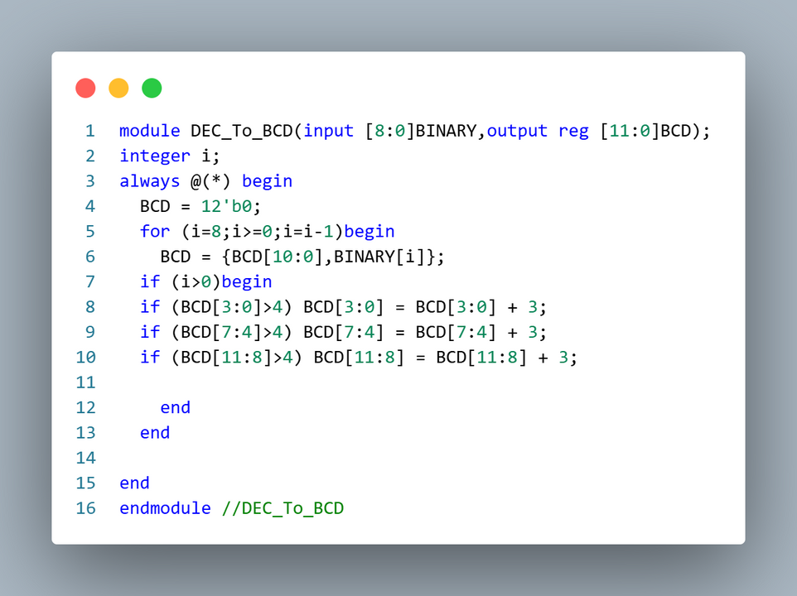
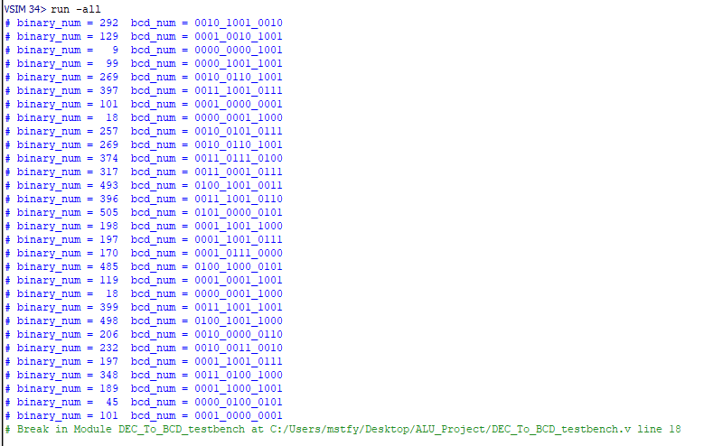
BINARY TO BCD
BCD
Binary
BCD is often employed when decimal numbers need to be represented directly in hardware, as each 4-bit BCD digit maps directly to a decimal digit.

Slide 14
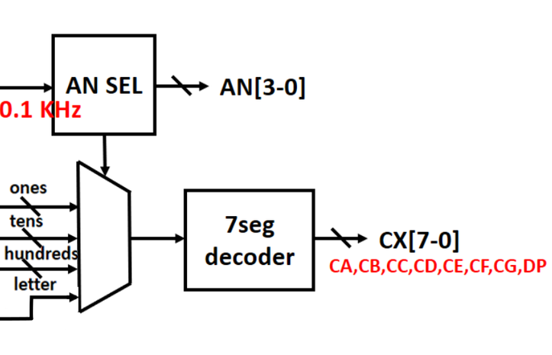
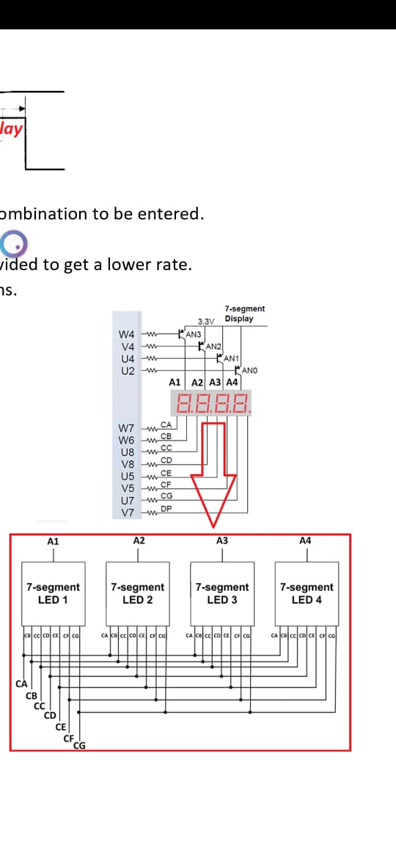
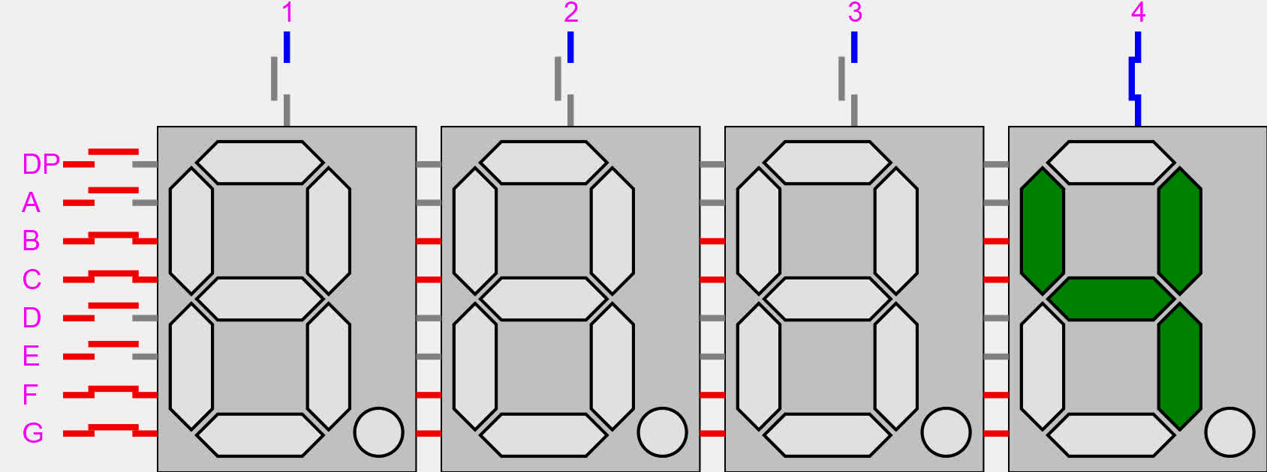
IMPLEMENTATION OF
7-SEGMENT DISPLAY ON FPGA
The diagram shows out approach to implement it. At a particular instant only one of the four 7 segment displays will be active and so on. The frequency for updating will be so fast that we won’t be able to notice the switching and it will appear as if it’s glowing continuously.
slow _clk

Slide 15
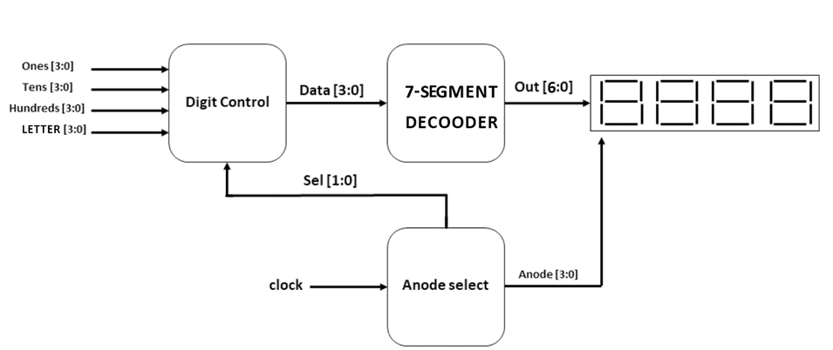
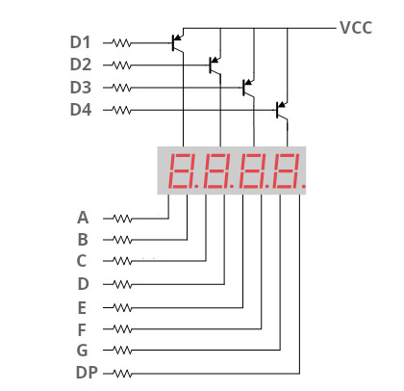
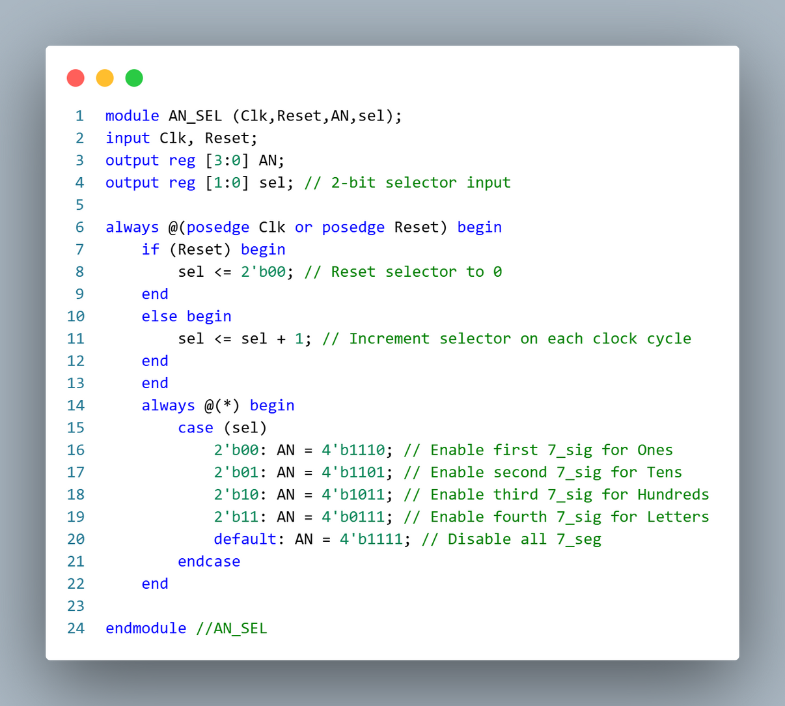
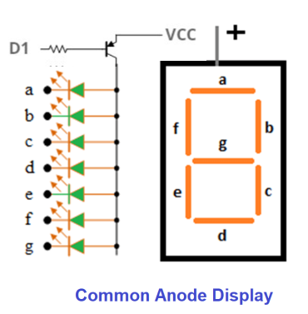
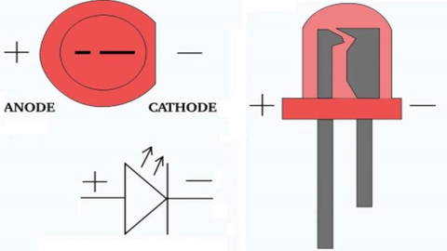
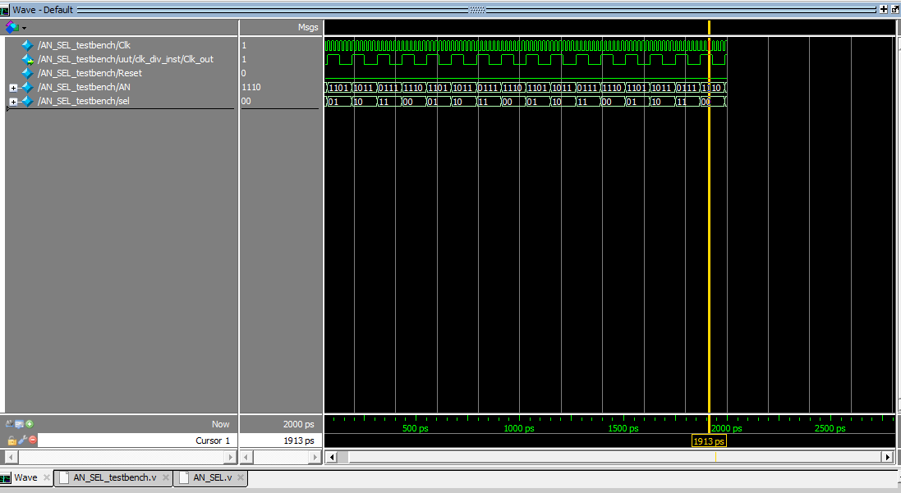
ANODE SELECTOR
PNP TRANS

Slide 16
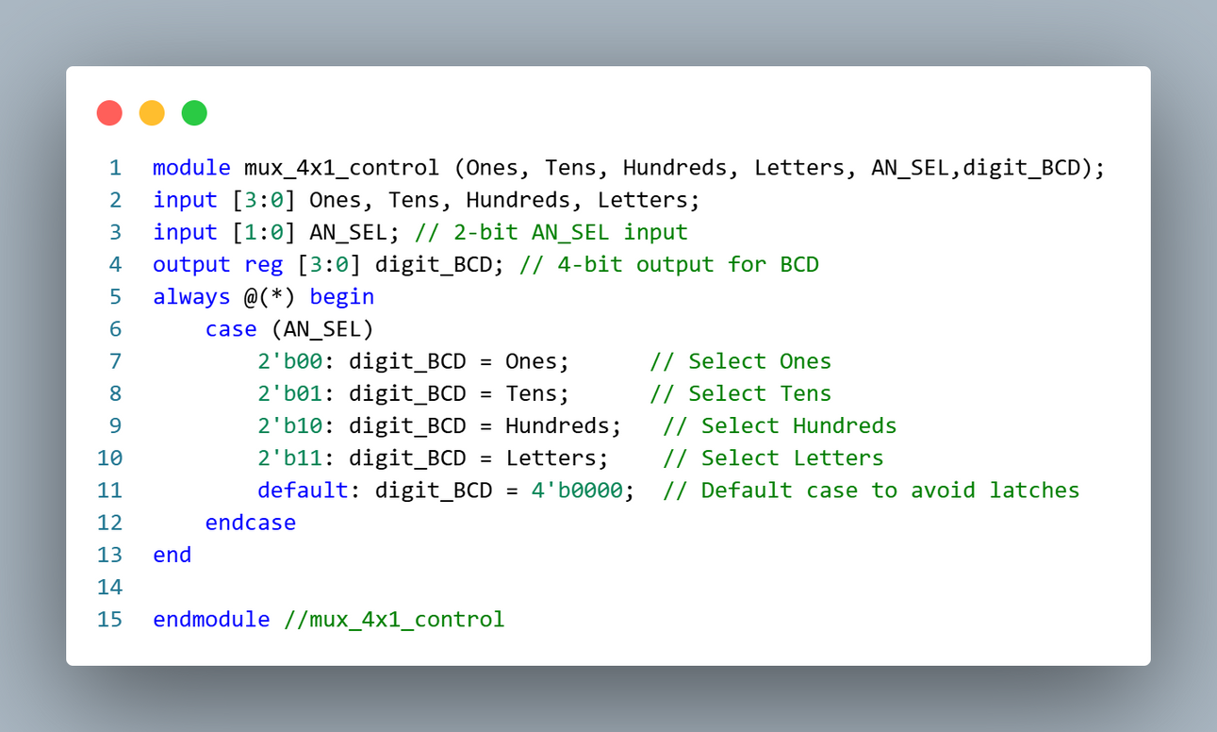
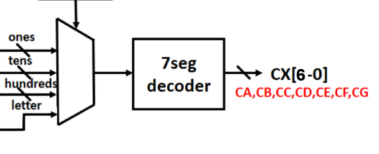
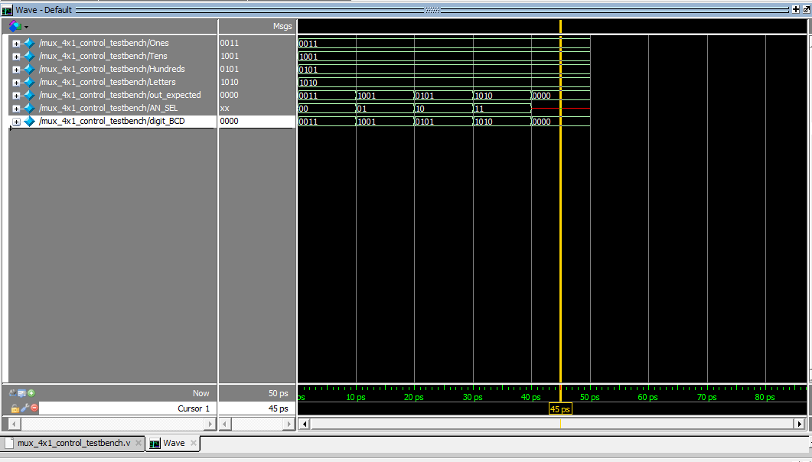
MUX 4x1 Control
SEL

Slide 17
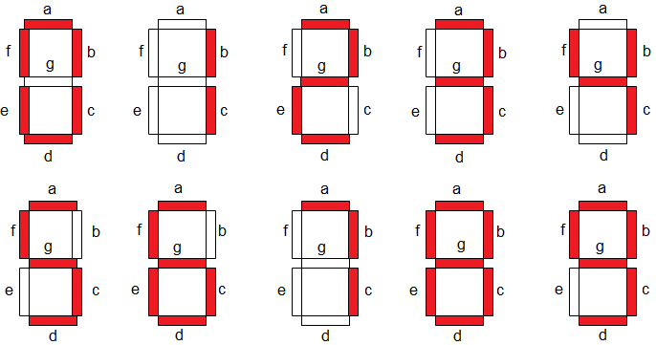
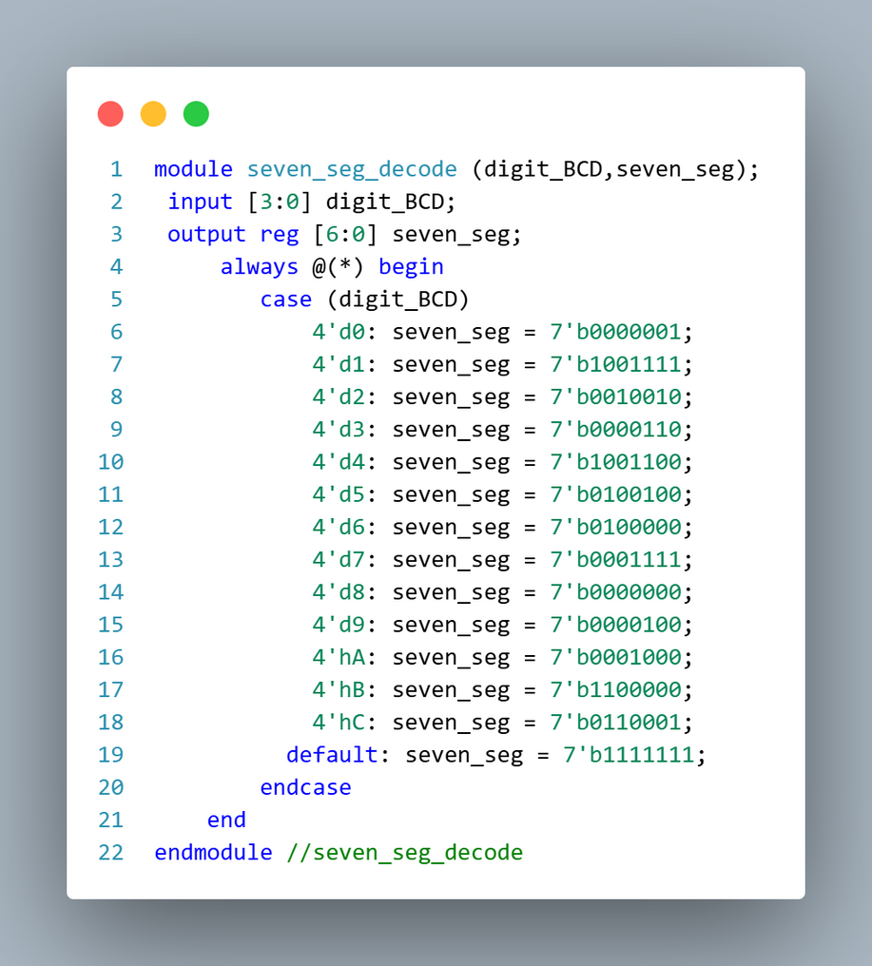
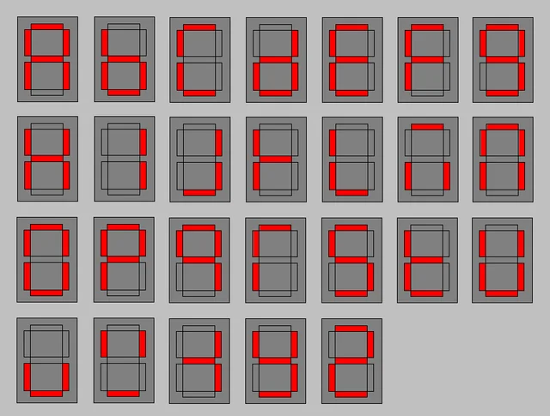
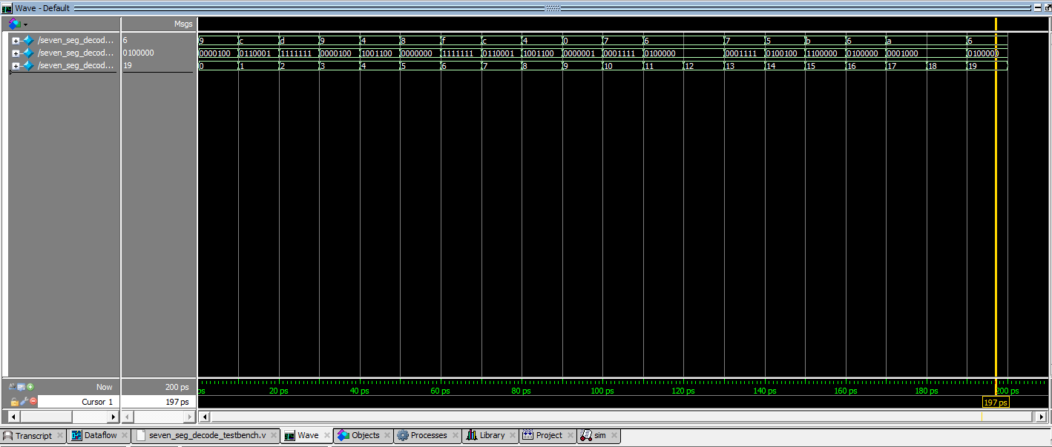
7 seg decooder

Slide 18
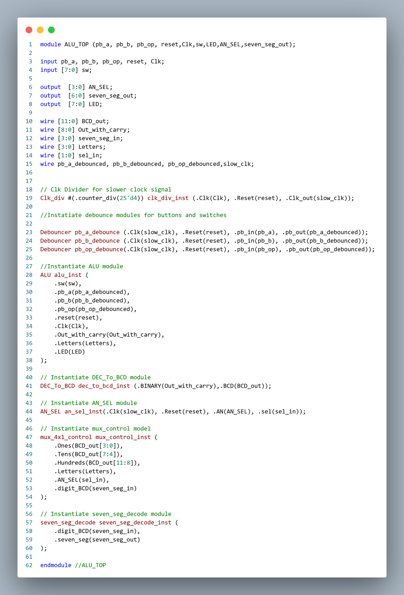
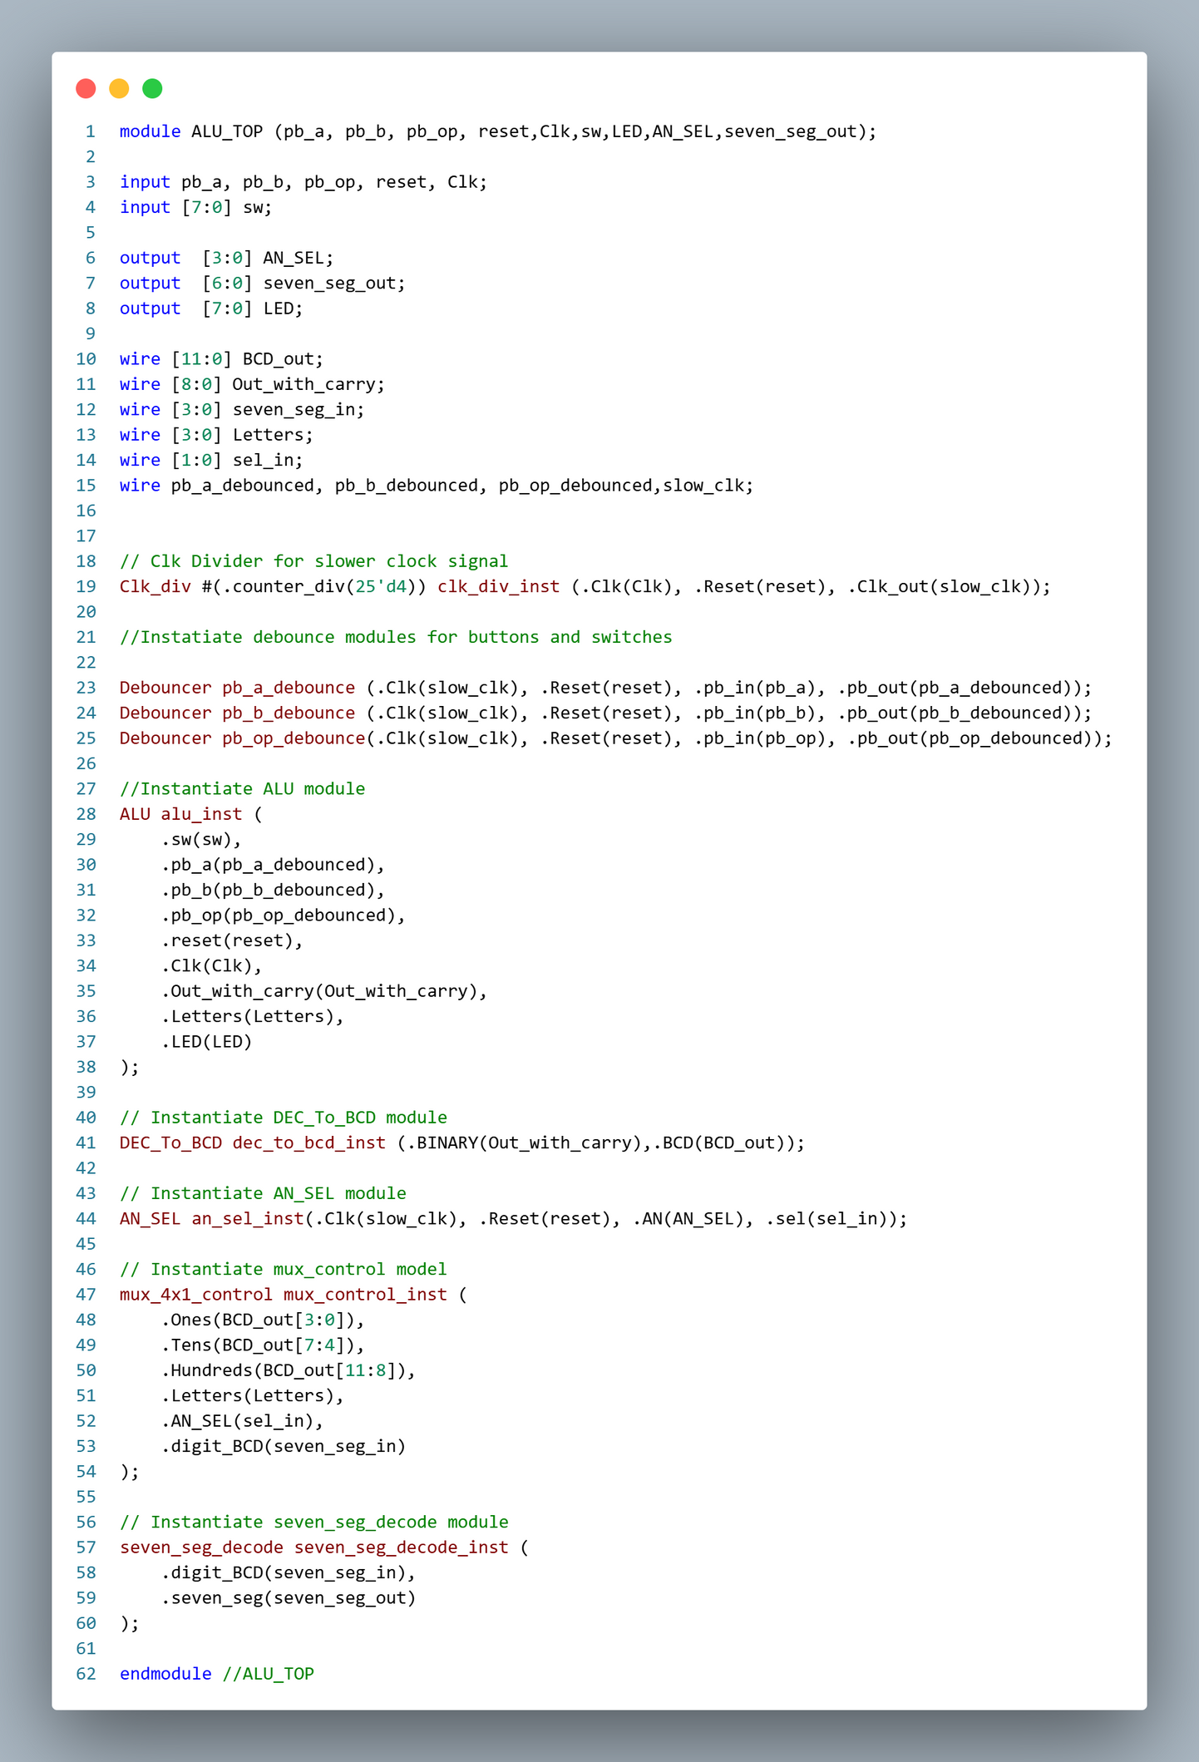
TOP Module
SEL[1:0]

Slide 19
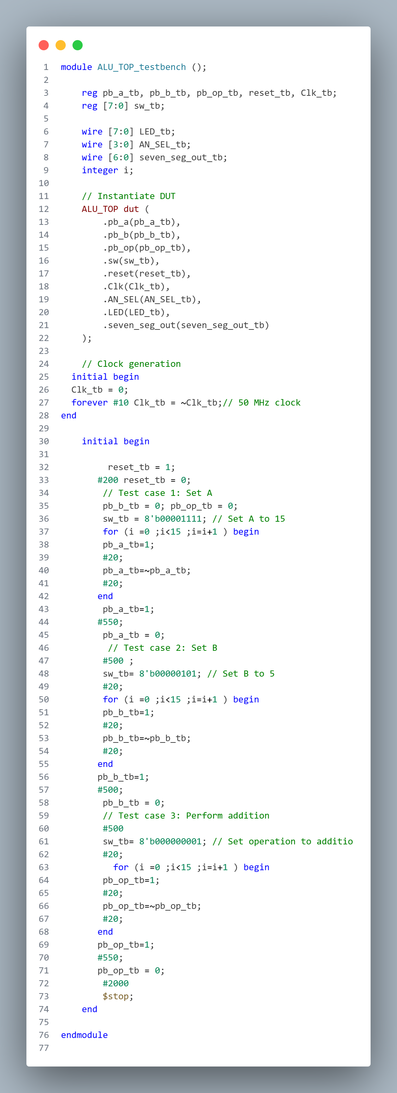


TOP Module TB

Slide 20
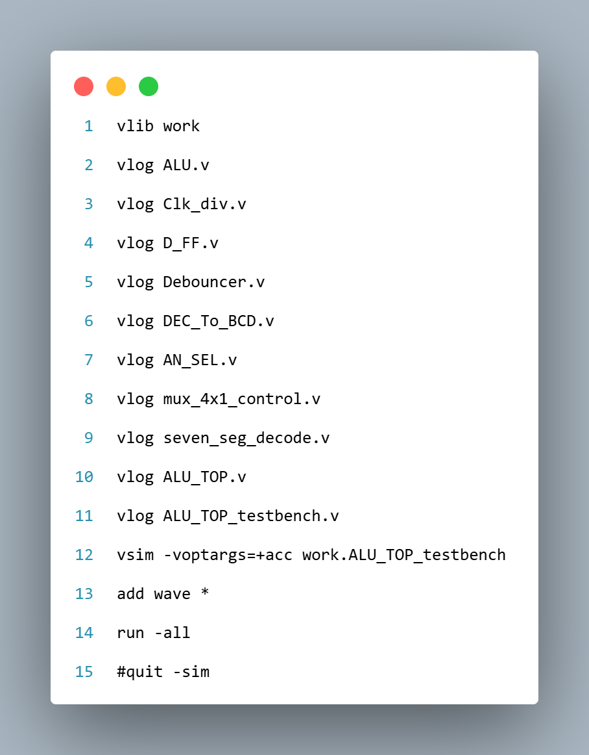
TOP Module TB
Do file

Slide 21
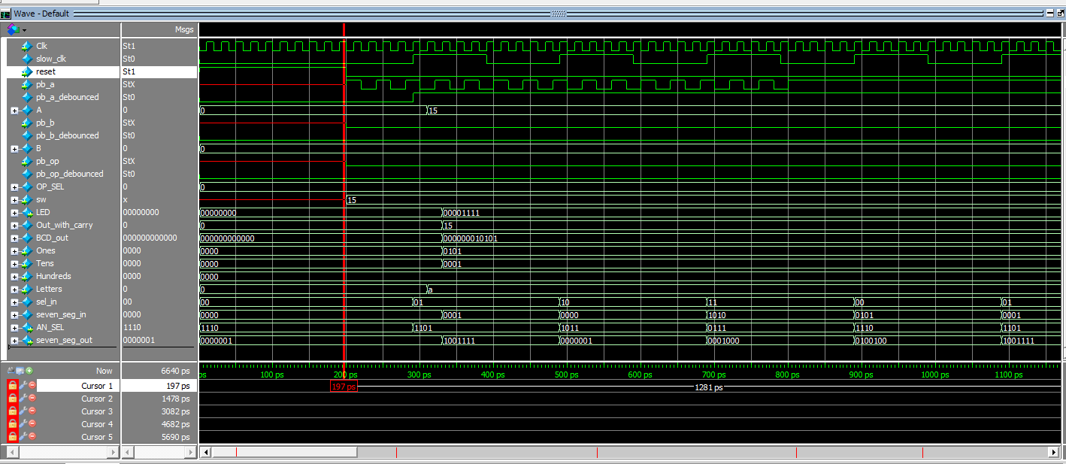
TOP Module TB
Reset On

Slide 22
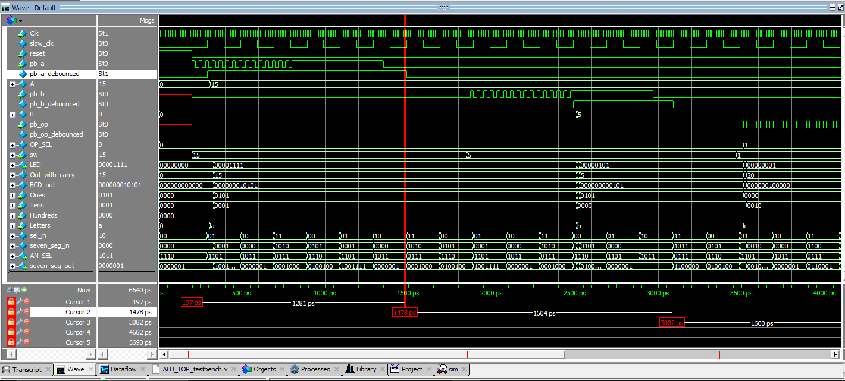
TOP Module TB
Pb_A On

Slide 23

TOP Module TB
Pb_B On

Slide 24

TOP Module TB
Pb_OP On

Slide 25

TOP Module TB
seven_seg_out

Slide 26

Conclusion
The full project, including all source files,
is available on GitHub: ALU_Project
Scan QR

Slide 27
THANK YOU

